Slide 1
STORING THE TRUSTED WEATHER REPORTS ON BLOCKCHAIN FOR THE BETTER PREDICTION by Vijay Sugali

Slide 2
OVERVIEW
Abstract
Introduction
Identification of problem
Possible solution
Method
Tasks
Working description
Result
Future work
References

Slide 3
ABSTRACT
There is a need to update with technology and improve the results from existing methods.
Prediction will be improved by using trusted and reliable data.
Using centralized servers is affects the reliability of the data.
Weather prediction accuracy can be improved by having trusted and reliable data.
An automated channel to measure, collect and store the data provides trusted and reliable data to predict weather with more accuracy.

Slide 4
INTRODUCTION
About Blockchain Technology
Decentralized server
Distributed network
Permanent ledger
Two-way encryption
Smart contracts
Cryptography
Hashing techniques
Digital signatures
About Internet of Things
Devices connected with internet
Smart distribution of information
Distributed way of communication
Sensors
Arduino Programming

Slide 5
IDENTIFICATION OF PROBLEM
The data may not be collected by genuine methods.
The data may be collected manually.
The data may be tampered by not maintaining proper systems.
The timestamp and location at the time collection of the data may not maintained well.

Slide 6
MAJOR ISSUES IN EXISTING SYSTEM
Data monitorization is done by admins. Admins can tamper the data for their own personal benefits, or they can access the data and sell to others.
Data can be destroyed due to natural hazards. There is no way to retrieve back.
Data is stored in servers either manually or by automated process. If data is stored manually, there will be human error.

Slide 7
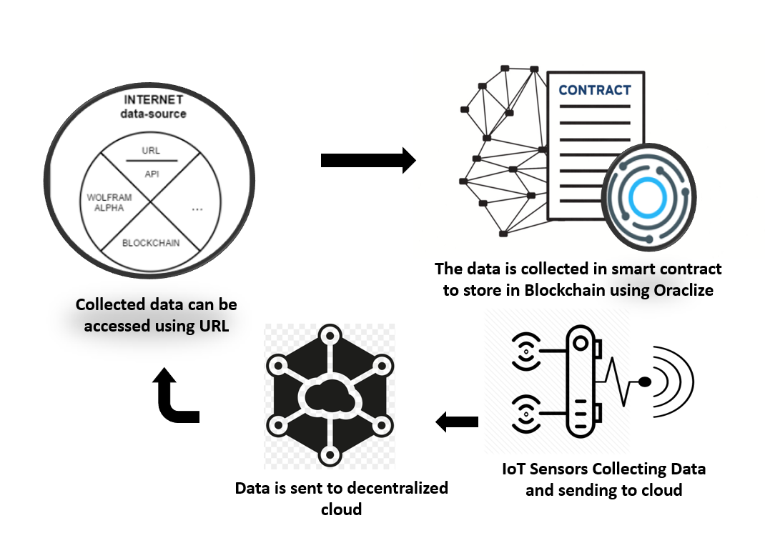
SOLUTION

Slide 8
PROPOSED METHOD
Measuring values using Internet of Things.
Sending the measured values into decentralized cloud.
Taking the data from decentralized cloud to smart contract using Oraclize technique.
Storing the collected data in Blockchain.

Slide 9
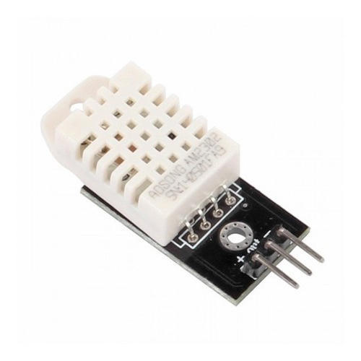

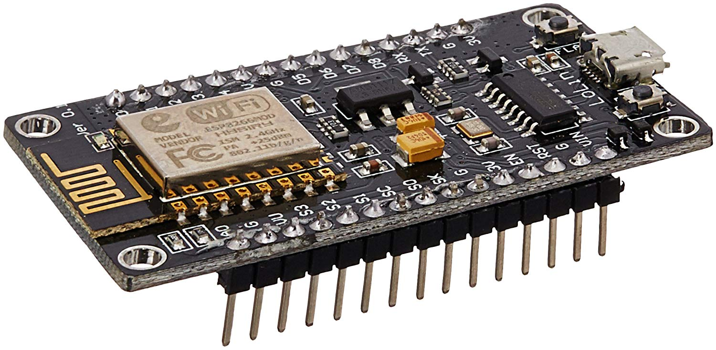
WORKING DESCRIPTION
We have taken some attributes and built an automated channel to provide trusted and reliable data.
We have taken temperature and humidity using DHT22 sensor, NodeMCU, Arduino programming, Thingspeak cloud service, Oraclize and Ethereum Blockchain.

Slide 10
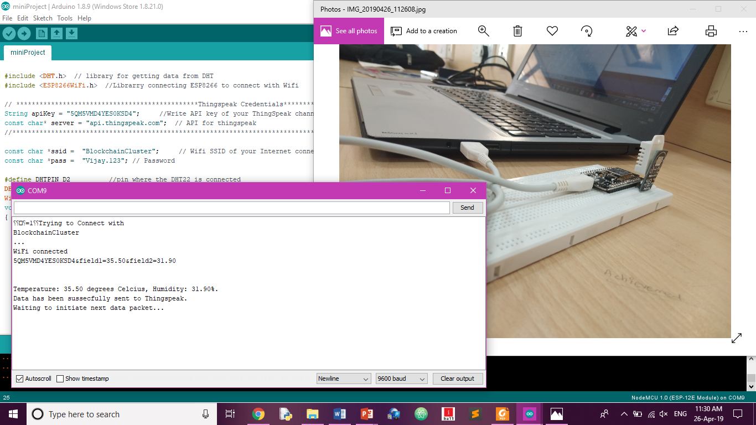
WORKING DESCRIPTION

Slide 11
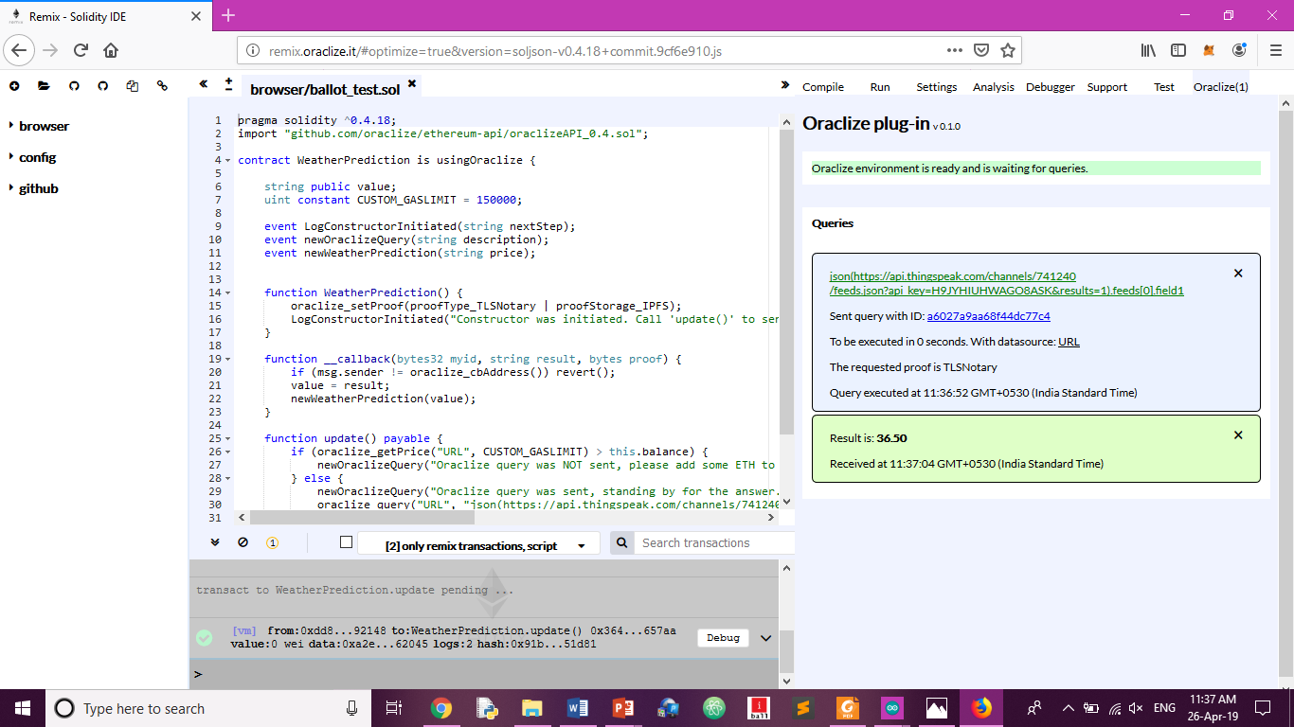
WORKING DESCRIPTION

Slide 12
RESULT
We have successfully built an automated channel to measure, collect and store the weather details in Blockchain. This data becomes trusted and reliable by the nature it is built. Hence, we hope the prediction accuracy will be improved by transforming the method from existing to the method we proposed through this project.

Slide 13
FUTURE WORK
By the successful integration of things with Blockchain, we can even extend this to other real-life applications.
One of the major applications is finding air quality index using IoT sensors and updating the measurements into the Blockchain with location and timestamp.
We know the air quality index is used to find the pollutant levels in the surroundings.
Hence, when government adopts this project and install these set up into various places of industries and factories, government can monitor whether the factories and industries are releasing the pollution up to the extent kept by the government.

Slide 14
REFERENCES
Satoshi Nakamoto, Bitcoin: A peer-to-peer electronic cash system, a white paper in 2008.
Edureka, https://www.edureka.co/blockchain-training?gclid=EAIaIQobChMIupS5ztSN3wIVVg4rCh1UAgk8EAAYASAAEgJ18_D_BwE, online certification course taken in 2017.
Arduino code, https://github.com/VeeruSubbuAmi/DHT22/blob/master/DHT22.ino
Prediction Algorithms, https://www.quora.com/What-are-weather-prediction-algorithms-Are-there-any-predefined-algorithms
Oraclize, https://docs.oraclize.it/#background
Solidity Open Source, https://solidity.readthedocs.io/en/v0.4.25/.

Slide 15
REFERENCES continued
Ethereum Community, https://readthedocs.org/projects/ethereum-homestead/.
Dapps, Ethereum community, http://ethdocs.org/en/latest/contracts-and-transactions/developer-tools.html.
Truffle framework, https://truffleframework.com/.
Gavin Wood, Ethereum yellow paper, https://ethereum.github.io/yellowpaper/paper.pdf sited in 2018.
Ethereum Community, Remix browser, https://remix.readthedocs.io/en/latest/.
Etherscan, https://etherscan.io/.
Metamask, https://metamask.io/.
Web3.js, Open docs, https://web3js.readthedocs.io/en/1.0/.
Coursera Buffalo University, Specialization on Blockchain, https://www.coursera.org/specializations/blockchain, taken in 2018.
New Zealand Transport Agency, https://vehicleinspection.nzta.govt.nz/virms/entry-certification/pre-reg-and-vin/vehicle-attributes/recording-vehicle-attributes, sited in 2013.
Post capes, https://www.postscapes.com/blockchains-and-the-internet-of-things/.
Xalentis, https://gideonvos.wordpress.com/2017/12/20/gps-iot-blockchain-integration-to-erp/.

Slide 16
THANK YOU

